Slide 1
Fractal Generator
Volodymyr Batrukh
Ihor Burkovych
AngryCoders team

Slide 2
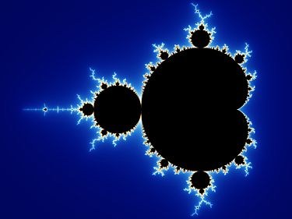
What is the “fractal”?
A fractal has been defined as "a rough or fragmented geometric shape that can be split into parts, each of which is (at least approximately) a reduced-size copy of the whole," a property called self-similarity.

Slide 3
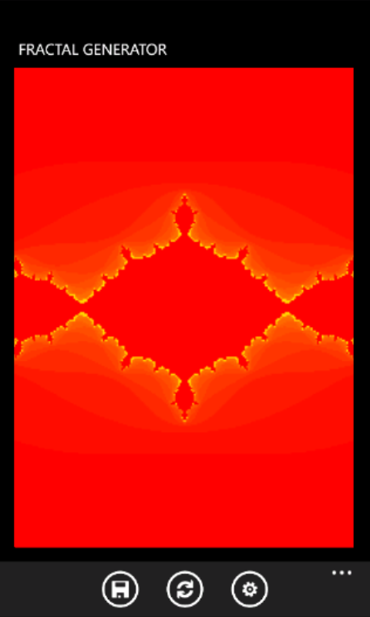
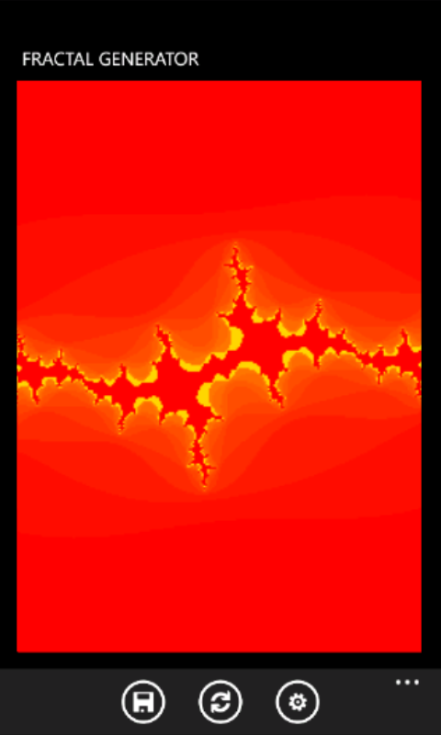
Fractal Generator

Slide 4
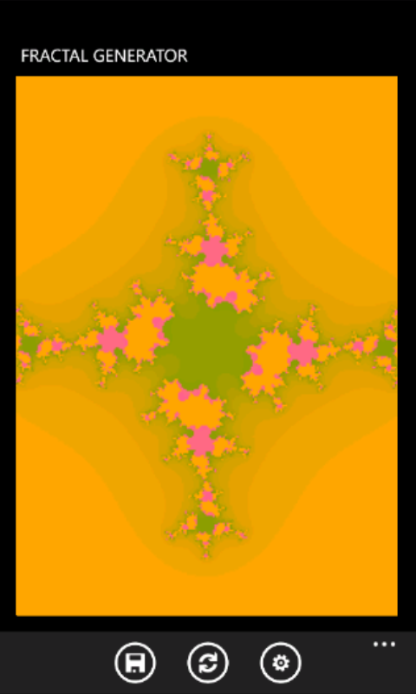
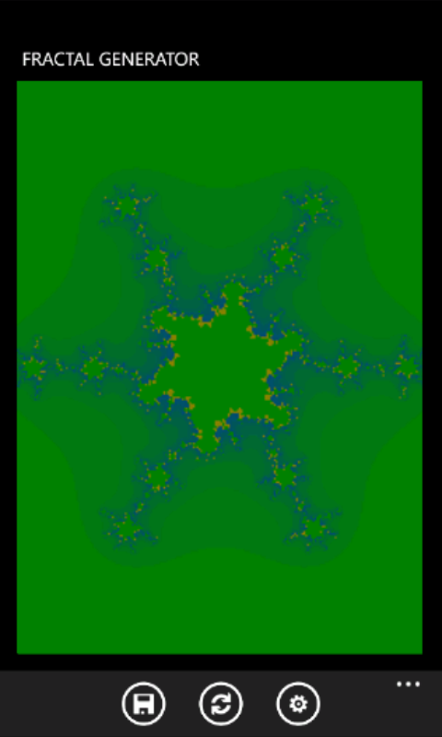
Fractal Generator

Slide 5
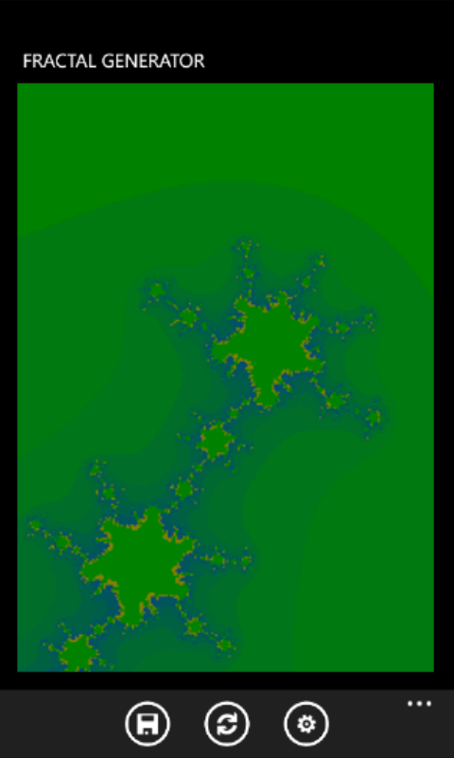
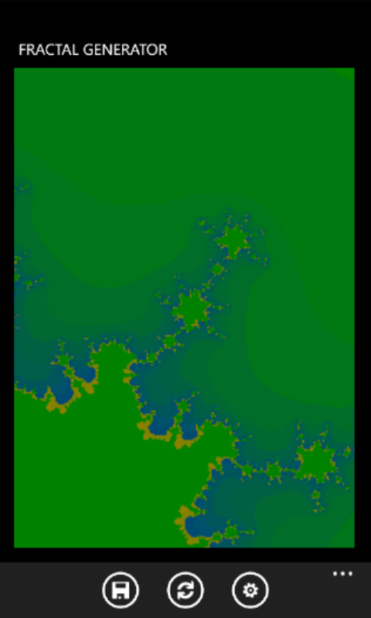

Fractal Generator. Zooming

Slide 6
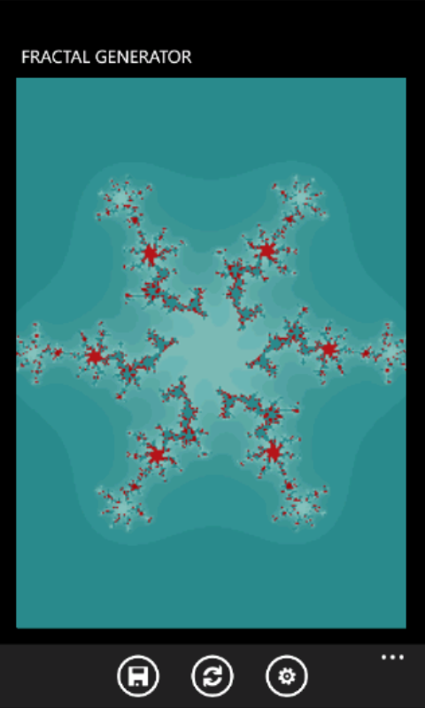
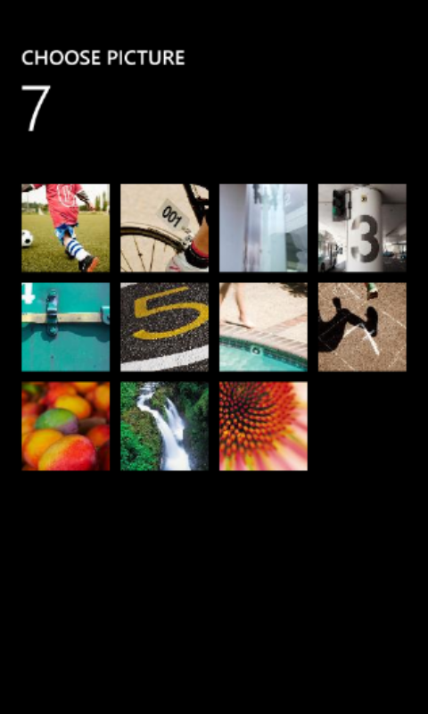
Custom colors

Slide 7
Thanks for attention
batrukh_volodya@ukr.net
iburkov@softserveinc.com

